Slide 1
Multiple access techniques for satellite communication
SLOT 1,2,3

Slide 2
Satellite Access
Introduction – FDMA, TDMA, CDMA
A transponder channel aboard a satellite may be fully loaded by a single transmission from an earth station. This is referred to as a single access mode of operation.
It is also possible, and more common, for a transponder to be loaded by a number of carriers. These may originate from a number of earth stations geographically separate, and each earth station may transmit one or more of the carriers. This mode of operation is termed multiple access.

Slide 3
The need for multiple access arises because more than two earth stations, in general, will be within the service area of a satellite. Even so-called spot beams from satellite antennas cover areas several hundred miles across.
The two most commonly used methods of multiple access are frequency- division multiple access (FDMA) and time-division multiple access (TDMA).
A third category of multiple access is code-division multiple access (CDMA). In this method each signal is associated with a particular code that is used to spread the signal in frequency and/or time.

Slide 4
All such signals will be received simultaneously at an earth station, but by using the key to the code, the station can recover the desired signal by means of correlation. The other signals occupying the transponder channel appear very much like random noise to the correlation decoder.
Multiple access also may be classified by the way in which circuits are assigned to users (circuits in this context implies one communication channel through the multiple-access transponder).

Slide 5
PREASSSIGNED AND DEMAND ASSIGNED
Circuits may be pre- assigned, which means they are allocated on a fixed or partially fixed basis to certain users.
These circuits are therefore not available for gen eral use. Preassignment is simple to implement but is efficient only for circuits with continuous heavy traffic.
An alternative to preassignment is demand-assigned multiple access (DAMA). In this method, all circuits are available to all users and are assigned according to the demand.

Slide 6
DAMA results in more efficient over- all use of the circuits but is more costly and complicated to implement.
Both FDMA and TDMA can be operated as preassigned or demand assigned systems. CDMA is a random-access system, there being no control over the timing of the access or of the frequency slots accessed.
These multiple-access methods refer to the way in which a single transponder channel is utilized. A satellite carries a number of transpon- ders, and normally each covers a different frequency channel. This provides a form of FDMA to the whole satellite.
It is also possible for transponders to operate at the same frequency but to be connected to different spot-beam antennas.

Slide 7
These allow the satellite as a whole to be accessed by earth stations widely separated geographically but transmitting on the same frequency. This is termed frequency reuse.
This method of access is referred to as space-division multiple access (SDMA). It should be kept in mind that each spot beam may itself be carrying signals in one of the other multiple-access formats.

Slide 8
Single Access
With single access, a single modulated carrier occupies the whole of the available bandwidth of a transponder. Single-access operation is used on heavy-traffic routes and requires large earth station antennas such as the class A antenna shown in
As an example, Telesat Canada pro- vides heavy route message facilities, with each transponder channel being capable of carrying 960 one-way voice circuits on an FDM/FM carrier, as illustrated in Fig. The earth station employs a 30-m-diameter antenna and a parametric amplifier, which together provide a minimum [G/T ] of 37.5 dB/K.

Slide 9
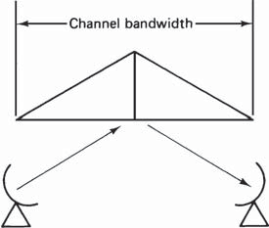
Heavy route message (frequency modulation— single access). (Courtesy of Telesat Canada, 1983.)

Slide 10
Preassigned FDMA
Frequency slots may be preassigned to analog and digital signals, and to illustrate the method, analog signals in the FDM/FM/FDMA format will be considered first. As the acronyms indicate, the signals are frequency- division multiplexed, frequency modulated (FM), with FDMA to the satellite.
It will be recalled that the voice-frequency (telephone) signals are first SSBSC amplitude modulated onto voice carriers in order to generate the single sidebands needed for the FDM.

Slide 11
For the purpose of illustration, each earth station will be assumed to transmit a 60-channel supergroup.
Each 60-channel supergroup is then frequency modulated onto a carrier which is then upconverted to a frequency in the satellite uplink band.
Figure shows the situation for three earth stations: one in Ottawa, one in New York, and one in London. All three earth stations access a single satellite transponder channel simultaneously, and each communicates with both of the others.
Thus it is assumed that the satel- lite receive and transmit antenna beams are global, encompassing all three earth stations.
Each earth station transmits one uplink carrier modulated with a 60-channel supergroup and receives two similar down- link carriers.

Slide 12
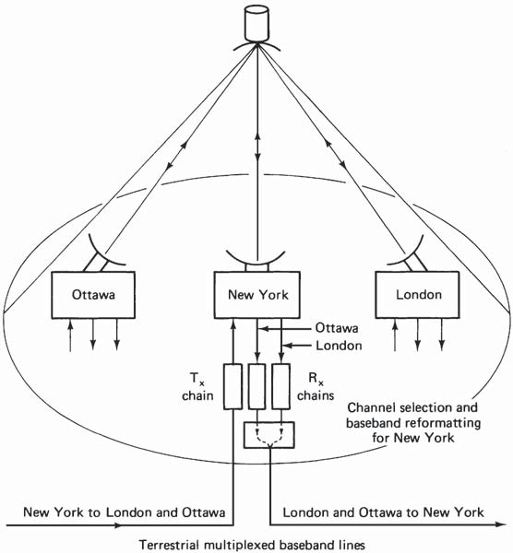
Three earth stations transmitting and receiving simultaneously through the same satellite transponder, using fixed-assignment FDMA.

Slide 13
The earth station at New York is shown in more detail. One transmit chain is used, and this carries telephone traffic for both Ottawa and London.
On the receive side, two receive chains must be provided, one for the Ottawa-originated carrier and one for the London-originated carrier.
Each of these carriers will have a mixture of traffic, and in the demultiplexing unit, only those telephone channels intended for New York are passed through.
These are remultiplexed into an FDM/FM format which is transmitted out along the terrestrial line to the New York switching office.

Slide 14
Figure shows a hypothetical frequency assignment scheme for the above hypothetical network
Uplink carrier frequencies of 6253, 6273, and 6278 MHz are shown for illustration purposes.
For the satellite transponder arrangement of Fig. these carriers would be translated down to frequencies of 4028, 4048, and 4053 MHz (i.e., the corresponding 4-GHz-band downlink frequencies) and sent to transponder 9 of the satellite.
Typically, a 60-channel FDM/FM carrier occupies 5 MHz of transponder bandwidth, including guardbands.

Slide 15
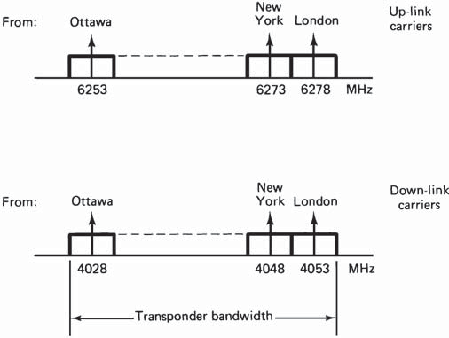
Figure Transponder channel assignments for the earth stations shown in above fig.
A total frequency allowance of 15 MHz is therefore required for the three stations, and each station receives all the traffic. The remainder of the transponder bandwidth may be unused, or it may be occupied by other carriers, which are not shown.
As an example of preassignment, suppose that each station can transmit up to 60 voice circuits and that 40 of these are preassigned to the New York–London route.

Slide 16
If these 40 circuits are fully loaded, additional calls on the New York–London route will be blocked even though there may be idle circuits on the other preassigned routes.
Telesat Canada operates medium-route message facilities utilizing FDM/FM/FDMA.
Figure shows how five carriers may be used to support 168 voice channels. The earth station that carries the full load has a [G/T] of 37.5 dB/K, and the other four have [G/T]’s of 28 dB/K.
Preassignment also may be made on the basis of a single channel per carrier (SCPC).

Slide 17
This refers to a single voice (or data) channel per carrier, not a transponder channel, which may in fact carry some hundreds of voice channels by this method.
The carriers may be frequency modulated or phase-shift modulated, and an earth station may be capable of transmitting one or more SCPC signals simultaneously.
Figure shows the INTELSAT SCPC channeling scheme for a 36-MHz transponder.
The transponder bandwidth is subdivided into 800 channels each 45-kHz wide.
The 45 kHz, which includes a guard- band, is required for each digitized voice channel, which utilizes quadrature phase-shift keying (QPSK) modulation. The channel information signal may be digital data or PCM voice signals

Slide 18
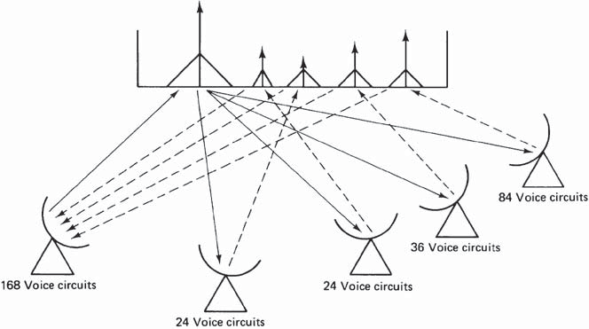
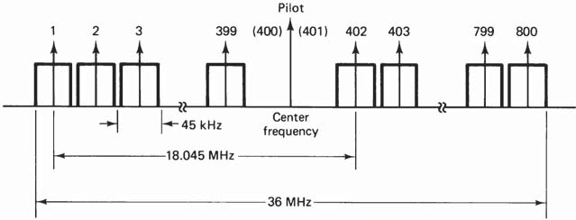
Figure Channeling arrangement for Intelsat SCPC system
Medium route message traffic (frequency-division multiple access, FM/FDMA). (Courtesy of Telesat Canada, 1983.)

Slide 19
A pilot frequency is transmitted for the purpose of frequency control, and the adjacent channel slots on either side of the pilot are left vacant to avoid interference.
The scheme therefore provides a total of 798 one- way channels or up to 399 full-duplex voice circuits. In duplex operation, the frequency pairs are separated by 18.045 MHz, as shown in Fig.
The frequency tolerance relative to the assigned values is within ±1 kHz for the received SCPC carrier and must be within ±250 Hz for the transmitted SCPC carrier (Miya, 1981).
The pilot frequency is transmitted by one of the earth stations designated as a primary station. This provides a reference for automatic frequency control (AFC) (usually through the use of phase-locked loops) of the transmitter frequency synthesizers and receiver local oscillators.

Slide 20
In the event of failure of the primary station, the pilot frequency is transmitted from a designated backup station.
An important feature of the INTELSAT SCPC system is that each channel is voice-activated. This means that on a two-way telephone conversation, only one carrier is operative at any one time. Also, in long pauses between speech, the carriers are switched off.
It has been estimated that for telephone calls, the one-way utilization time is 40 percent of the call duration. Using voice activation, the average number of carriers being amplified at any one time by the transponder traveling- wave tube (TWT) is reduced

Slide 21
For a given level of intermodulation distortion the TWT power output per FDMA carrier therefore can be increased.
SCPC systems are widely used on lightly loaded routes, this type of service being referred to as a thin route service.
It enables remote earth stations in sparsely populated areas to connect into the national telephone network in a reasonably economical way. A main earth station is used to make the connection to the telephone network, as illustrated in fig.

Slide 22
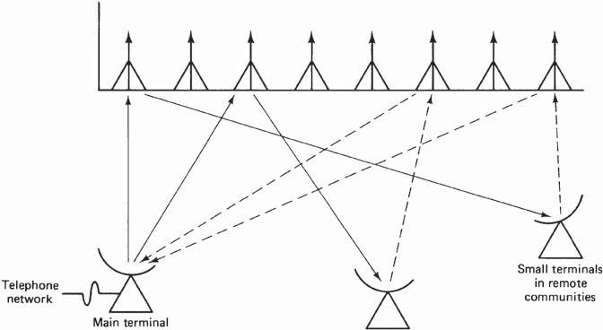
Figure Thin route message traffic (single channel per carrier, SCPC/FDMA). (Courtesy of Telesat Canada, 1983.)
The Telesat Canada Thin Route Message Facilities pro- vide up to 360 two-way circuits using PSK/SCPC (PSK = phase-shift keying).
The remote terminals operate with 4.6-m-diameter antennas with [G/T ] values of 19.5 or 21 dB/K.
Transportable terminals are also available, one of these being shown in Fig.
This is a single- channel station that uses a 3.6-m antenna and comes complete with a desktop electronics package which can be installed on the customers’ premises.

Slide 23
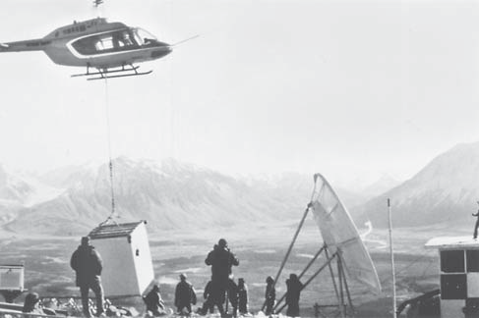
Figure Transportable message station. (Courtesy of Telesat Canada, 1983.)

Slide 24
Demand-Assigned FDMA
In the demand-assigned mode of operation, the transponder frequency bandwidth is subdivided into a number of channels. A channel is assigned to each carrier in use, giving rise to the single-channel-per-carrier mode of operation discussed in the preceding section.
As in the preassigned access mode, carriers may be frequency modulated with analog information signals, these being designated FM/SCPC, or they may be phase modulated with digital information signals, these being designated as PSK/SCPC.
Demand assignment may be carried out in a number of ways. In the polling method, a master earth station continuously polls all the earth stations in sequence, and if a call request is encountered, frequency slots are assigned from the pool of available frequencies. The polling delay with such a system tends to become excessive as the number of participating earth stations increases.

Slide 25
Instead of using a polling sequence, earth stations may request calls through the master earth station as the need arises. This is referred to as centrally controlled random access.
The requests go over a digital orderwire, which is a narrowband digital radio link or a circuit through a satellite transponder reserved for this purpose. Frequencies are assigned, if available, by the master station, and when the call is completed, the frequencies are returned to the pool. If no frequencies are available, the blocked call requests may be placed in a queue, or a second call attempt may be ini- tiated by the requesting station.
As an alternative to centrally controlled random access, control may be exercised at each earth station, this being known as distributed con- trol random access. A good illustration of such a system is provided by the Spade system operated by INTELSAT on some of its satellites.

Slide 26
SPADE
The word Spade is a loose acronym for SCPC pulse-code-modulated multiple-access demand-assignment equipment. Spade was developed by Comsat for use on the INTELSAT satellites (see, e.g., Martin, 1978) and is compatible with the INTELSAT SCPC preassigned system
However, the distributed-demand assignment facility requires a common signaling channel (CSC). This is shown in Fig. The CSC bandwidth is 160 kHz, and its center frequency is
18.045 MHz below the pilot frequency, as shown in Fig.
To avoid interference with the CSC, voice channels 1 and 2 are left vacant, and to maintain duplex matching, the corresponding channels 1' and 2' are also left vacant. Recalling from Fig. that channel 400 also must be left vacant, this requires that channel 800 be left vacant for duplex matching.

Slide 27
Thus six channels are removed from the total of 800, leaving a total of 794 one-way or 397 full-duplex voice circuits, the frequencies in any pair being separated by 18.045 MHz, as shown in Fig. (An alternative arrangement is shown in Freeman, 1981.)
All the earth stations are permanently connected through the CSC. This is shown diagrammatically in Fig. for six earth stations A, B, C, D, E, and F.
Each earth station has the facility for generating any one of the 794 carrier frequencies using frequency synthesizers. Furthermore, each earth station has a memory containing a list of the frequencies currently available, and this list is continuously updated through the CSC.

Slide 28
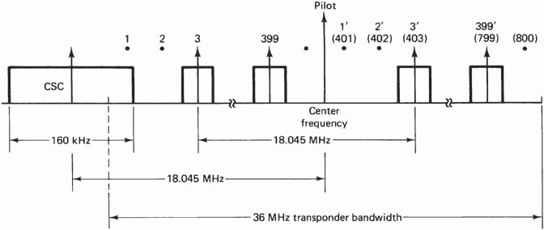
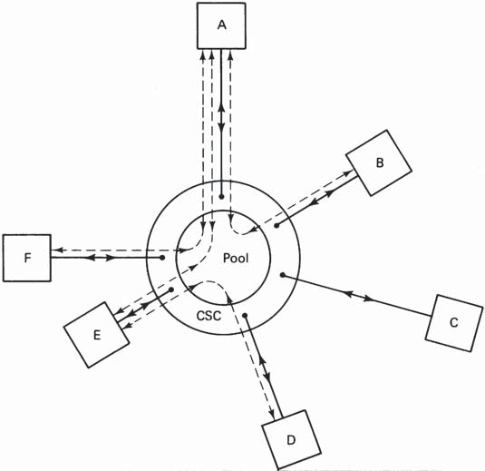
Figure Channeling scheme for the Spade system.
Figure Diagrammatic representation of a Spade communications system.

Slide 29
To illustrate the procedure, suppose that a call to station F is initiated from station C in Fig.
Station C will first select a frequency pair at random from those currently available on the list and signal this information to station F through the CSC.
Station F must acknowledge, through the CSC, that it can complete the circuit.
Once the circuit is established, the other earth stations are instructed, through the CSC, to remove this frequency pair from the list.
The round-trip time between station C initiating the call and station F acknowledging it is about 600 ms.

Slide 30
During this time, the two frequencies chosen at station C may be assigned to another circuit. In this event, station C will receive the information on the CSC update and will immediately choose another pair at random, even before hearing from station F.
Once a call has been completed and the circuit disconnected, the two frequencies are returned to the pool, the information again being trans- mitted through the CSC to all the earth stations.
As well as establishing the connection through the satellite, the CSC passes signaling information from the calling station to the destination station, in the example above from station C to station F.

Slide 31
Signaling information in the Spade system is routed through the CSC rather than being sent over a voice channel.
Each earth station has an equipment called the demand assignment signaling and switching (DASS) unit which performs the functions required by the CSC.
Some type of multiple access to the CSC must be provided for all the earth stations using the Spade system. This is quite separate from the SCPC multiple access of the network’s voice circuits.

Slide 32
Bandwidth-Limited and Power-Limited TWT Ampliﬁer Operation
A transponder will have a total bandwidth B_{TR}, and it is apparent that this can impose a limitation on the number of carriers that can access the transponder in an FDMA mode.
For example, if there are K carriers each of bandwidth B, then the best that can be achieved is K = B_{TR}/B. Any increase in the transponder EIRP will not improve on this, and the system is said to be bandwidth-limited.
Likewise, for digital systems, the bit rate is determined by the bandwidth, which again will be limited to some maximum value by B_{TR}.

Slide 33
Power limitation occurs where the EIRP is insufficient to meet the [C/N] requirements.
The signal bandwidth will be approximately equal to the noise bandwidth, and if the EIRP is below a certain level, the bandwidth will have to be correspondingly reduced to maintain the [C/N] at the required value

Slide 34
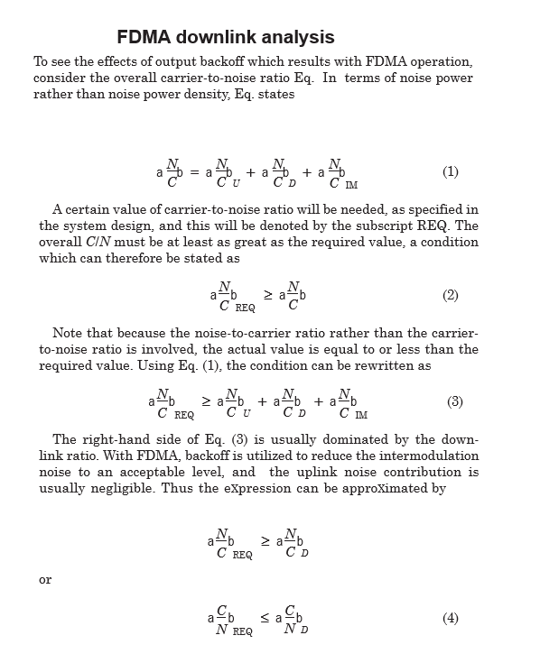

Slide 35
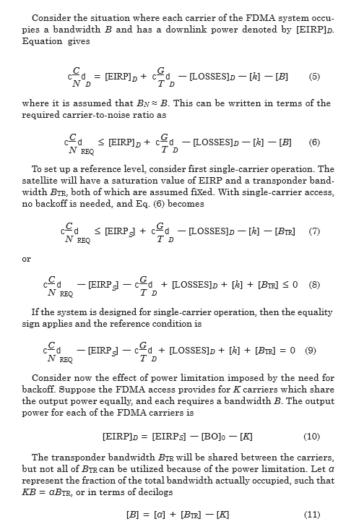

Slide 36
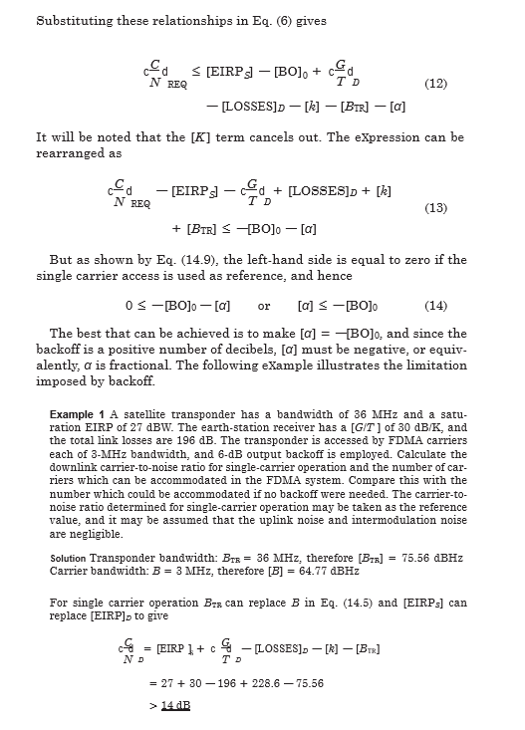

Slide 37
